Slide 1

Into the world of anime an exploration and analysis
DATs 6103
Crystal Kao, pranideep meka, Swathi Murali Srinivasan

Slide 2
Outline
Introduction
EDA
SMART Questions
Summary

Slide 3
What is anime?
Anime, also known as Japanese animation, is a genre of entertainment originating in Japan but has become popularized throughout the world, especially internationally in the last 20 years (Anime Industry Data, n.d.).
The data used in the following exploration and analysis comes from Anime Planet, a place where you can “discover anime and manga, track your progress, watch anime, read manga” (Anime Planet, n.d.).
The dataset itself comes from Kaggle and contains over 18,000 anime entries over the last 100 years and contains a diverse set of variables.

Slide 4
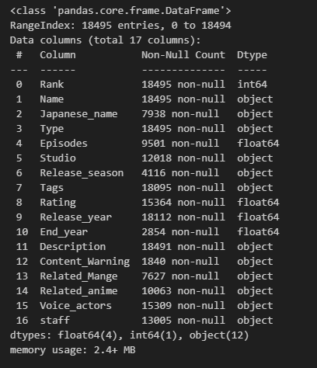
The dataset
The data contains 18,495 entries with the following columns available:

Slide 5
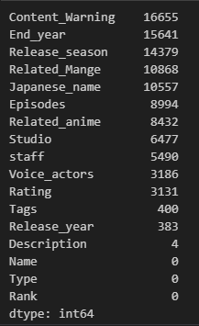
Missing Values
Number of Missing Values in each Column
As seen in the previous table, the number of non-null values is inconsistent in the columns, meaning the dataset needs to be cleaned and reformatted

Slide 6
Removal of missing values
The easiest way to clean the data is to remove all the rows with null values if it does not affect the dataset too much. However, as seen here, we are only left with 40 entries if all null values are removed so this is not a reasonable method of cleaning the data

Slide 7
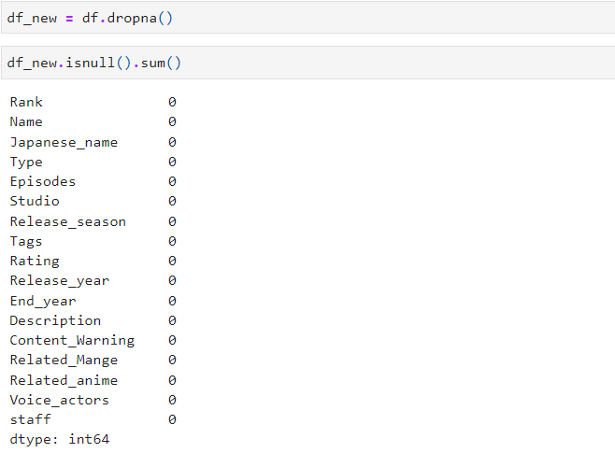
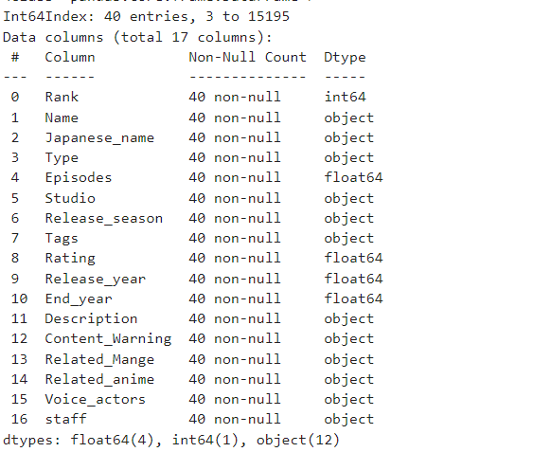
Missing Values Strategy: Drop All Values: --Not Possible

Slide 8
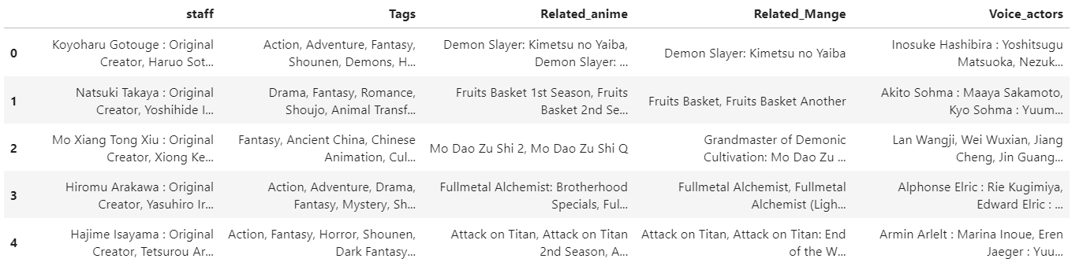
Feature Engineering:
we uses a lambda function (Anonymus Function)to count the number of string 'columns' by splitting the string at ','. If 'columns' is not empty, it calculates the length; otherwise, it sets 'columns' to 0.
Advantages: Strings are converted into the integers

Slide 9
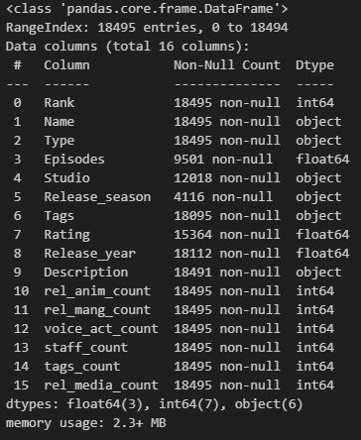
Removal of missing values: strategy-2 removing the unwanted columns:
‘Japanese_name’, ‘End_year’, ‘Content_Warning’, ‘Related_Mange’ were removed due to more than 50% of the columns being null values and are not relevant to our current analysis
Unnecessary spaces were removed from ‘Type’
Count columns were created for ‘Voice_actors’, ‘staff’,‘Related_anime’, ‘Related_Mange’, and ‘Tags’
the original columns were then removed
This creates columns based on integers instead of strings
‘Related_anime’ and ‘Related_Mange’ counts were also added together to create a ‘rel_media_count’ column

Slide 10
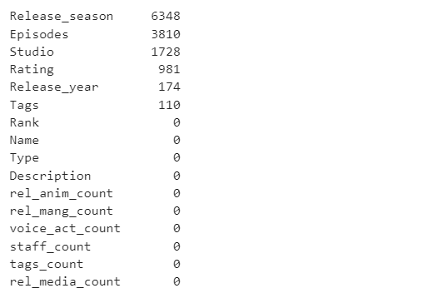

Feature- Description
Removing the value = “No synopsis Yet come back soon! ”

Slide 11
Exploratory data analysis

Slide 12
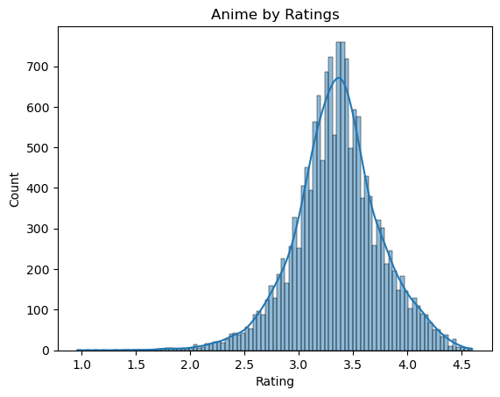
Anime Ratings
The majority of anime tend to fall within the rating range of 3 to 4, indicating that only a small number of anime received exceptionally high ratings.

Slide 13
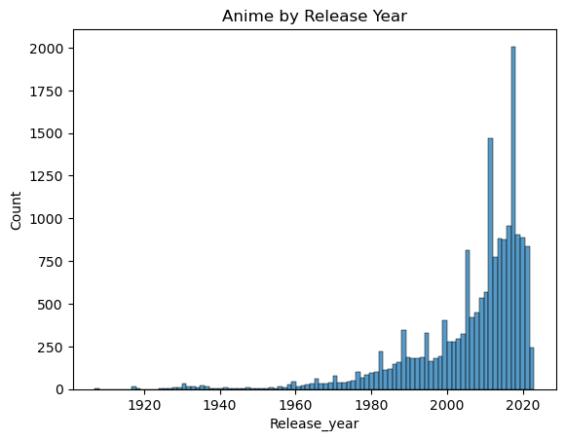
Anime Release year
Most anime were released within the last 10 to 15 years, which aligns with the significant growth observed in the manga and anime industry during the late 2010s (Anime Industry Data, n.d.).

Slide 14
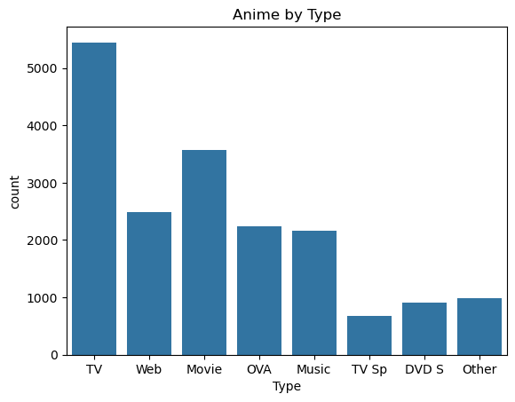
Anime media type
TV has the most anime shows available for viewing.

Slide 15
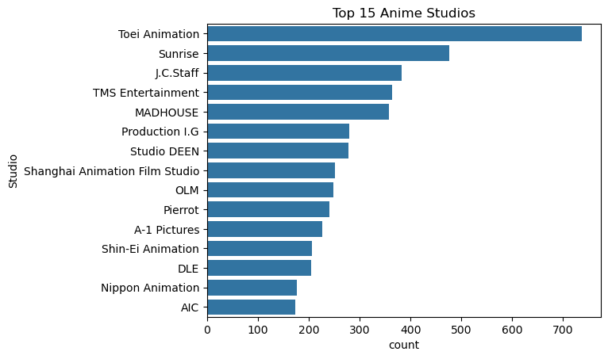
Top 15 anime studios
Toei Animation produces the most anime of any studio and the gap between first and second is over 200 anime
Interestingly there's a Chinese animation studio in the top 15 animation studio list. Chinese anime, also known as donghua, has also become popular in recent years.

Slide 16
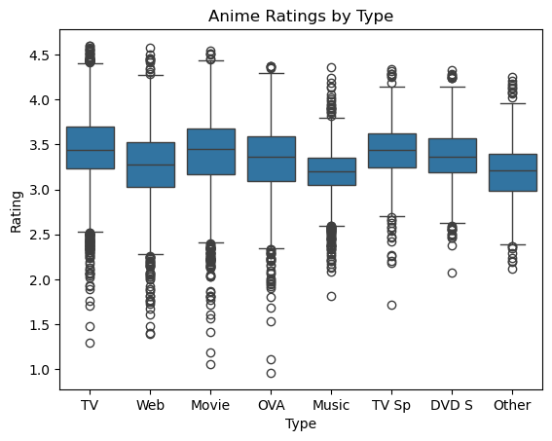
Anime ratings by type
TV Sp (TV specials), even though there are less anime hosted on it, tends to get a higher average rating.

Slide 17
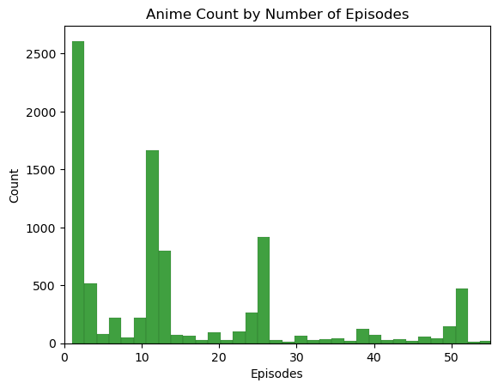
Number of episodes
Most anime with only one episode can be considered as movies since they typically have one episode. The next most common episode count is around 12, which is the average length for TV shows or Original Video Animations (OVA).

Slide 18
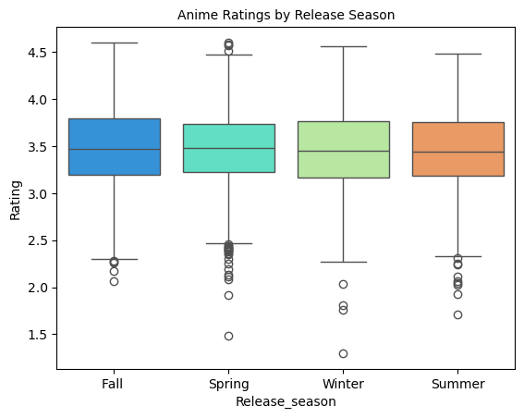
Ratings by Season
Anime releases are often categorized by season. When looking at ratings by season, there does not seem to be much of a difference between the seasons as all of them have a mean rating of ~3.5.

Slide 19
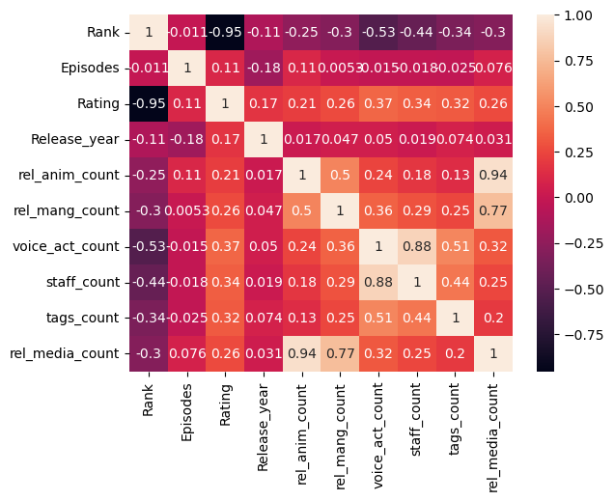
correlation
Rankings are created based on ratings so ignore that correlation. Also ignore the correlation between related media and related anime and manga because those fields make up related media.
There is an interestingly strong negative correlation between the number of voice actors and rank.
The count of staff and voice actors have a relatively high correlation with each other. This makes sense since the more voice actors you have, the more staff you need.

Slide 20
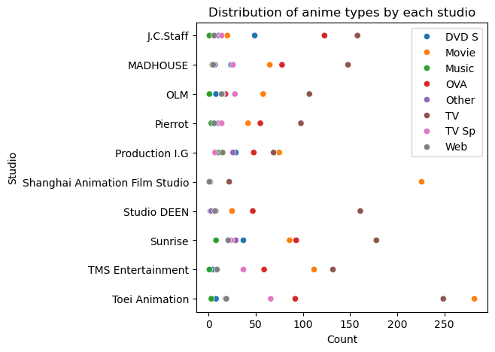
Anime Type by top studios
The studios mostly produce TV shows (brown) and movies (orange).

Slide 21
Smart Questions

Slide 22
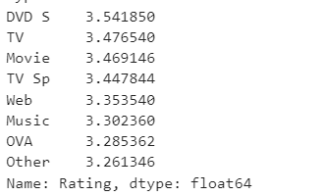
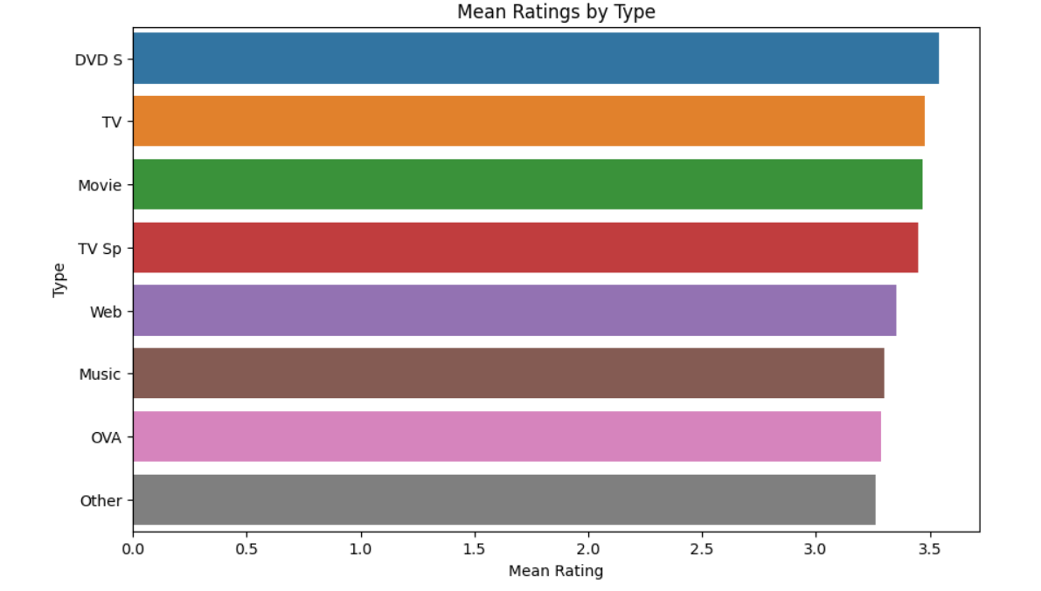
1.How does the type of anime (e.g., TV series, movie, OVA) relate to the average user ratings on Anime Planet? Are there significant differences in ratings based on the type of anime?

Slide 23
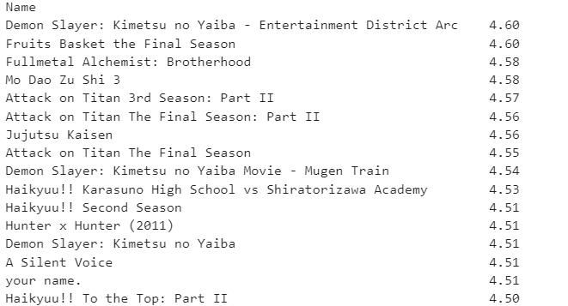
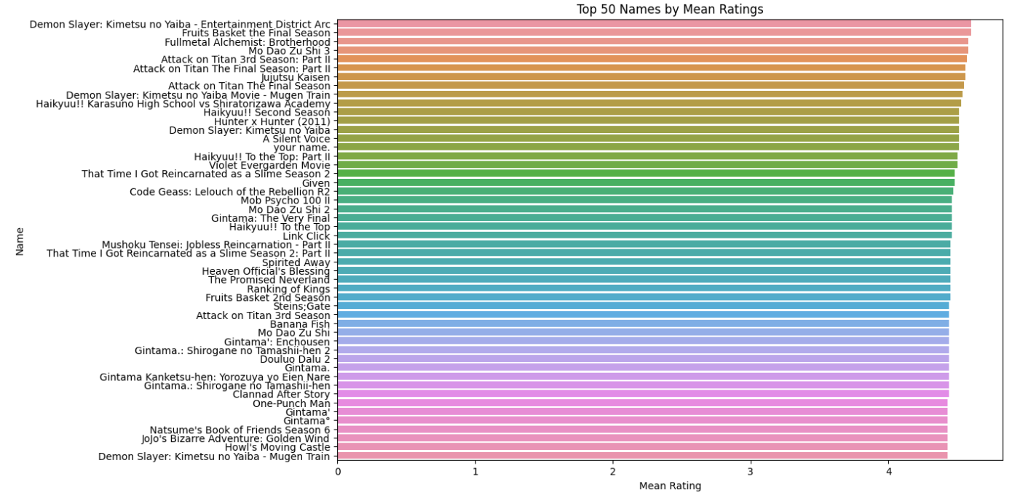
based on type of animae average user ratings:

Slide 24

2. Can we predict the user ratings of anime based on the available information such as the studio, release season, and tags? What factors have the most significant impact on an anime's rating, and can we build a predictive model for anime popularity?
To answer this question, a model is needed and additional data cleaning is also needed.

Slide 25
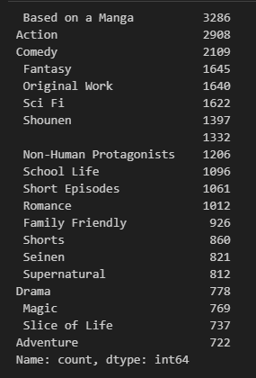
Filling missing values
List of Tags
Missing episode values were filled using the median, as anime seasons typically have 12 episodes
Missing release years were also filled using the median
Missing studio values were filled by randomly selecting a studio
The Tags, Studio, Type, Release_season were transformed from a column to a list to facilitate binary classification through one-hot encoding

Slide 26
Model
We initially created a DataFrame comprised of rows with unavailable ratings. This dataset will be utilized in the final stage to predict the ratings for these anime entries.
Next we split our data for training and testing.
Rating, Name, Tags, Index, and Rank were dropped
The results of the model are:
This model can now be used to predict ratings for anime missing a rating value or new anime that are released.
Mean Absolute Error: 0.22168
Mean Squared Error: 0.08718
R²: 0.16859

Slide 27
Summary
Anime tend to be rated between 3-4
Most anime were released in the last 10-15 years
The most common type of anime are tv shows
The season the anime is released during doesn’t affect the ratings significantly
TV shows have the highest mean ratings, followed by TV specials.
The model created has a mean square error close to 0, meaning our model is performing well and can be used to predict ratings of new and unknown anime

Slide 28
Conclusion
The analysis that we have done is to help navigate someone who is new to anime and help them in being able to make a recommendation to get them started with what to watch. This could entail making a recommendation system based on the user ratings. ​

Slide 29
References
Anime Industry Data: 日本動画協会. The Association of Japanese Animations. (n.d.). https://aja.gr.jp/english/japan-anime-data
Welcome to anime-planet. Anime. (n.d.). https://www.anime-planet.com/
Mane, V. (2022, January 16). Anime dataset 2022. Kaggle. https://www.kaggle.com/datasets/vishalmane10/anime-dataset-2022/data

Slide 30
Thank you

